Slide 1
Writing to describe Character descriptions and the senses
Aims:
To understand how to create a description using the 5 senses
To think about how to convey characters in descriptive writing

Slide 2
Starter- you have 5 minutes to write down as many words as you can under each sense that describes the Learning Centre:
Touch
Smell
Sight
Senses
Taste
Sound

Slide 3
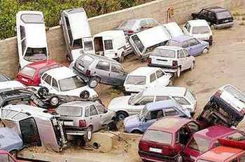
Describe this scene relying ONLY on your senses.
Sight
What can you see? How would you describe it?
Sound
What can you hear? What words could you use to describe the sound?
Smell
What fragrances are in the air?
Touch
What texture can you feel? What kind of temperature is it?
Taste
Can you almost taste any of the aromas?

Slide 4
Character descriptions
In pairs read the 4 character descriptions
Task 1:
Rank them in order of which descriptions are the most successful
Task 2:
Look more closely at the ‘best’ and ‘worst’ descriptions. Why did you choose them? What did they do well? How could they be improved?
Be prepared to explain and justify your
choices to the class.

Slide 5
A bored looking teenager sat slumped on a bench, her eyes rimmed with thick black eyeliner. The new ‘bullet for my Valentine’ single pounded from her mp3 headphones which were thrust into her ears.

Slide 6
Just as indecisive as the man in the Home department, women stare helplessly at the silver in the jewellery department. Their eyes sparkle more than the diamonds embedded in the rings and necklaces. A mixture of perfumes trail from the mob of women that hunt for the bargain jewellery that they can wear for their nights out with the girls.

Slide 7
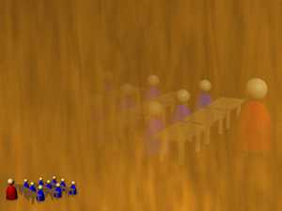
In the very popular store Millie’s Cookies, the first toddlers have been denied a cookie by mothers and, not surprisingly, they cry.

Slide 8
A pigtailed sixteen year old at the tills bites her nails, growing irritated at the snail speed of the till workers.

Slide 9
Top tips for creating character descriptions:
Capture brief snippets of characters- try to convey their mood in this description
Focus on the individuals, families or couples, who inhabit the scene
Try to include approximately 3-4 short character descriptions
Try to use a variety of different senses
Zoom in on small, authentic details
Show don’t tell (He was angry becomes As he clenched his fist he glared…)
Use interesting vocabulary- especially focus on the verb choices (He strolled…)
Create a sense of physical description by describing their facial expressions, posture, clothing etc

Slide 10
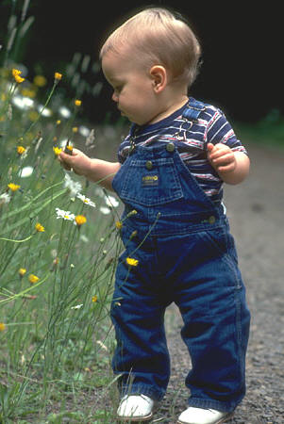
Choose ONE image and mind map a description of them. Focus on their facial expressions, body language, appearance.

Slide 11
Now, develop this into one to two paragraphs of detailed description.
Remember to SHOW don’t tell and zoom in on small details. Try to use a variety of senses.
Homework- finish your description and write it up neat. Make sure it is really polished (check spelling and punctuation). Due…Tuesday W9

